Slide 1

Sentiment Analysis of Movie Reviews (INTRODUCTION TO AI (AI-201B)) Even Semester Session 2024-25
Tushar Kumar-202410116100227
Vanshika Srivastava -202410116100236
Vanshika Tyagi-202410116100237
Vikas Singh -202410116100244
Project Supervisor:
Mrs. Komal Salgotra
Assistant professor

Slide 2


Movie Sentiment Analysis: Unveiling Audience Emotions
Explore how sentiment analysis transforms movie insights. Discover how technology captures audience emotions effectively. This unveils trends and enhances film experiences.
Notes:
1

Slide 3

Understanding Sentiment Analysis
Sentiment analysis comprehends emotions in text. It spans social media, e-commerce, and health.
Wide Applications
Key Insight
Used in marketing, politics, and understanding movie reputations.
Offers insights into audience emotional responses.
Overall Quality
Helps gauge a movie's overall reputation and quality.
Notes:
2

Slide 4




The Power of Movie Sentiment Analysis
It captures individual emotional states. This bridges user interests and cinematic products.
Addresses Need
Addresses growing film industry needs for better algorithms.
Captures States
Offers insights into public opinions and industry trends.
Provides Insight
Offers insights into public opinions on films.
Notes:
3

Slide 5
Machine Learning Techniques
Key techniques include Logistic Regression and Naïve Bayes.
Core Techniques
Performance
Logistic Regression
BERT: 98% accuracy
Naïve Bayes
LinearSVC: 90.98% accuracy
Support Vector Machines (SVM)
BERT
Notes:
4

Slide 6
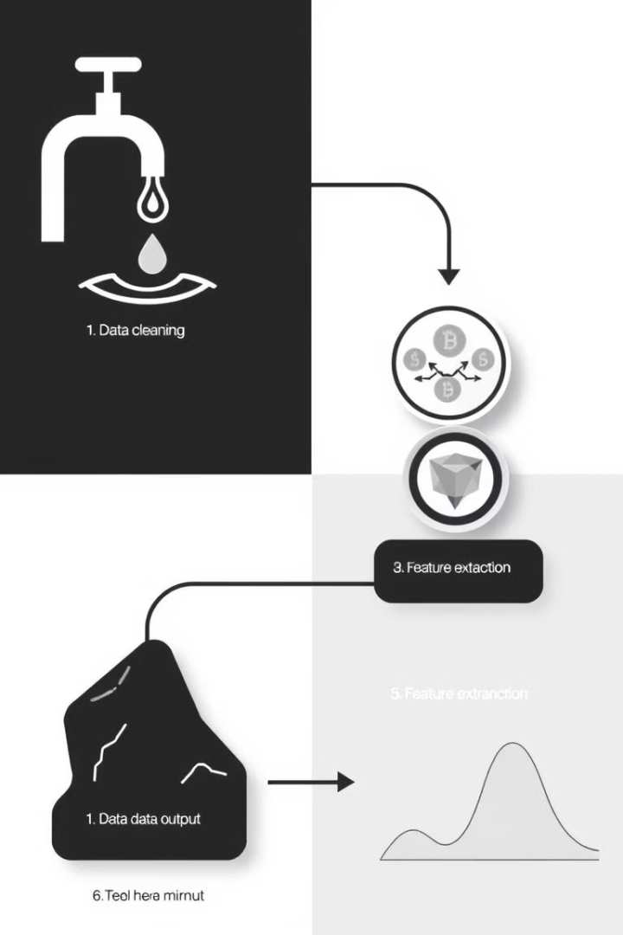
Data Preprocessing
Key preprocessing steps include data cleaning and tokenization.
Data Cleaning
Remove noise for accuracy.
Tokenization
Break text into tokens.
Feature Extraction
Use Bag-of-Words and TF-IDF.
Notes:
5

Slide 7

Advanced Sentiment Analysis Approaches
Deep learning revolutionizes sentiment analysis. It adapts to evolving user sentiments.
Transformers
Transfer Learning
Understand complex context.
Improves accuracy with less data.
Emotional Responses
Nuanced emotional variations.
Notes:
6

Slide 8



Real-World Applications
It uses collaborative filtering. This combines approaches to improve system effectiveness.
Collaborative Filtering
2
Recommend based on user behavior.
Sentiment Analysis
1
Analyze text feedback.
Marketing Strategies
3
Tailor marketing campaigns.
Notes:
7

Slide 9
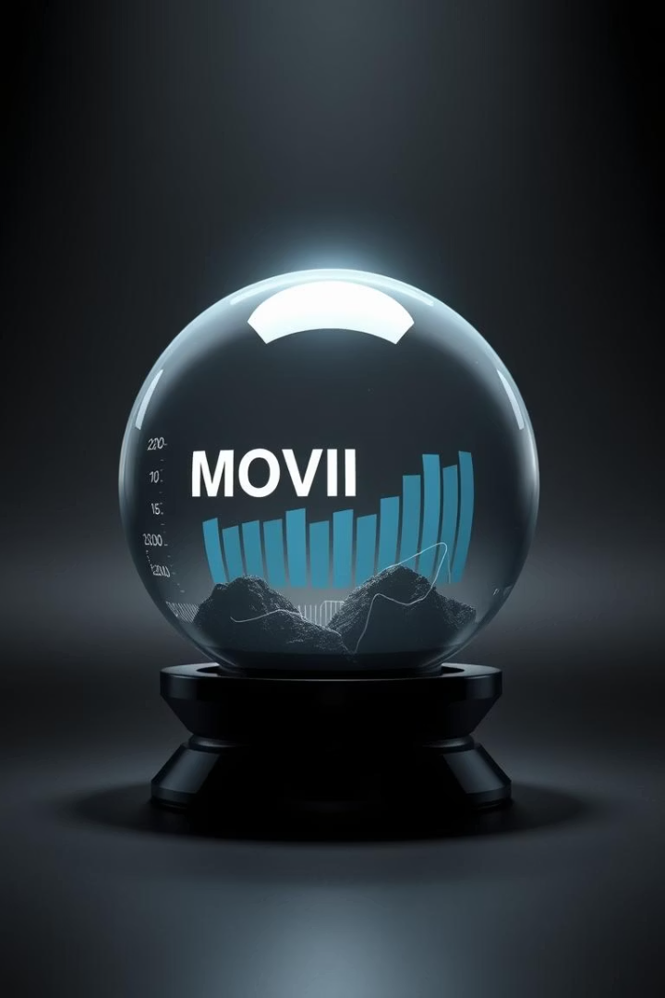
Future of Sentiment Analysis
Expect continuous improvement in techniques. It will enhance movie understanding.
1
Predicting Trailers
Movie sentiment from trailers.
2
Multimodal Analysis
Integrate various data types.
3
Live Sentiment Tracking
Real-time feedback analysis.
Notes:
8

